Slide 1
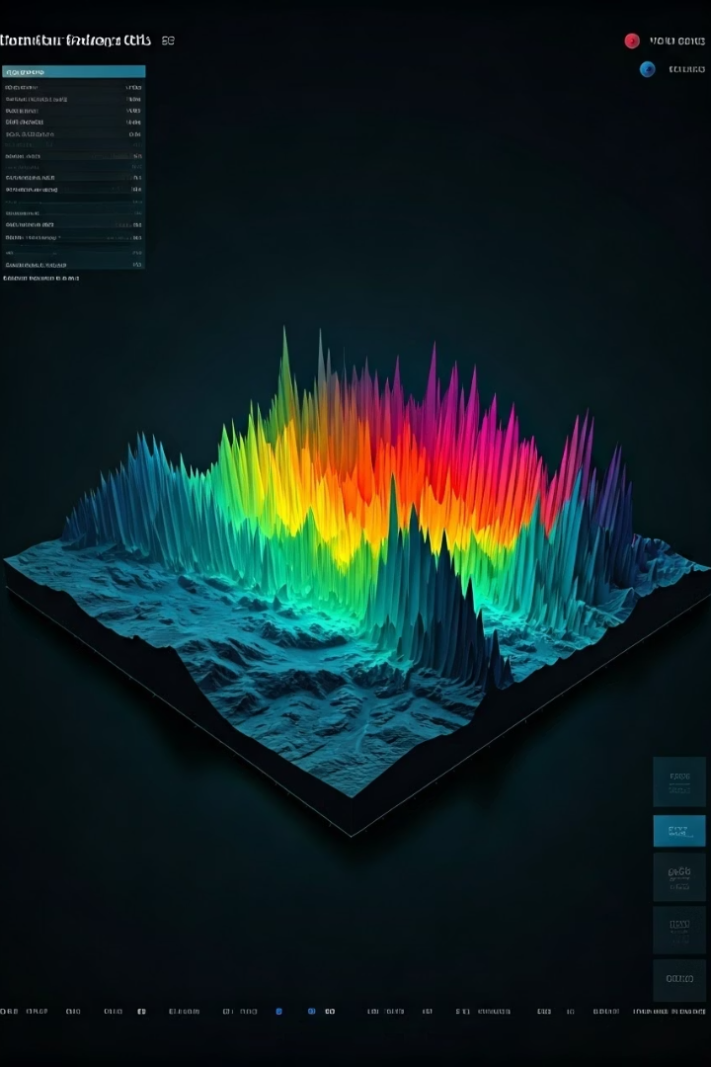
Earthquake Data Fusion and Visualization Analysis Report

Slide 2
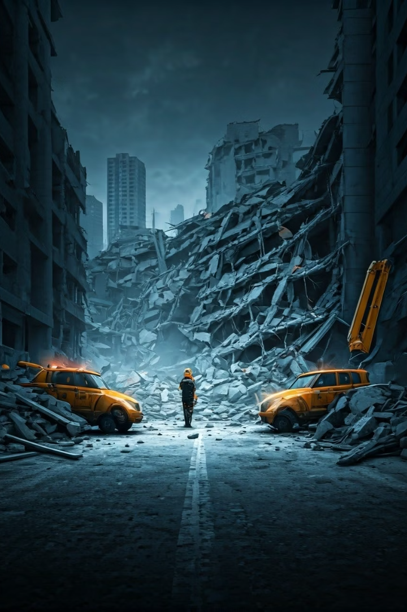
Project Background
Challenge
Earthquakes are sudden and highly destructive natural disasters. Timely and accurate assessment of their impact is crucial for emergency response and resource allocation.
Solution
This project integrates subjective public reports (DYFI) with objective instrument data (PGA), builds a Bayesian state-space model, and visualizes community-level intensity and uncertainty to support emergency decision-making.

Slide 3
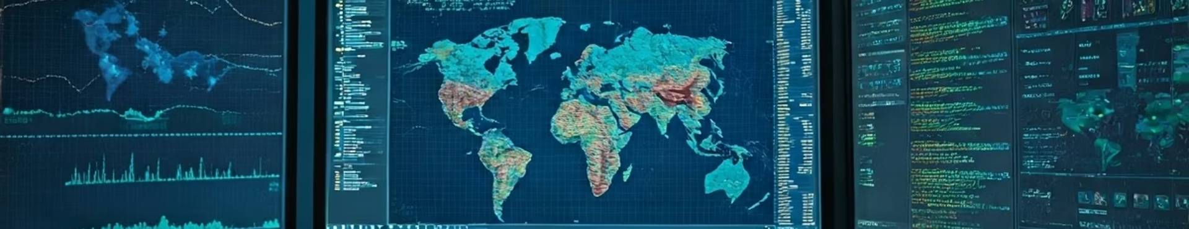




Data Preparation and Processing
DYFI reports
Instrumental maps
Timestamp, location, MMI (subjective intensity)
PGA/PGV values, epicenter, magnitude (objective strength)
Community boundaries
Population density
GeoJSON format polygons
Population count per community (used for weighting reliability)

Slide 4





Modeling Approach
State variable θt
True intensity per community
Observations yt
DYFI MMI and instrument-derived MMI
State equation
θt = θt-1 + wt
Observation equation
yt = θt + vt

Slide 5
Visualization Techniques
Intensity Encoding
Uncertainty Visualization
Supplementary Visualizations
Intensity (E[θt]) is encoded using color
Uncertainty (Var[θt]) is visualized with transparency
Bar charts display report counts and reliability per community to detect data blind spots
Warm colors (red, orange) indicate higher intensity areas
Higher opacity indicates more confident estimates
Helps identify areas needing additional data collection
Cool colors (blue, green) show lower intensity regions
Lower opacity shows areas with greater uncertainty

Slide 6








Data Fusion Mechanism
Adaptive Weighting
Threshold Detection
The model adaptively adjusts weights based on noise estimation
If differences exceed threshold, manual review is triggered
Continuous Update
Data Prioritization
System continuously refines estimates as new data arrives
Priority given to PGA data when conflicts arise

Slide 7






Decision Support
Immediate Rescue (Red)
MAP≥7 & CIR≤1.25
Prepare Supplies (Purple)
5≤MAP<7 & CIR≤2.5
Monitor and Standby (Blue)
Others
Response priority matrix based on MAP (Maximum A Posteriori) and CIR (Confidence Interval Ratio) guides emergency resource allocation decisions.

Slide 8
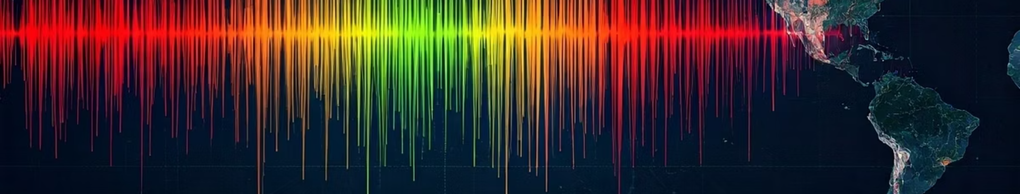
Visualization Optimization and Conclusion
Future Applications
Model Benefits
This approach can be extended to other natural disasters requiring integration of subjective reports and objective measurements.
Color Enhancement
The fusion model improves the accuracy and timeliness of earthquake intensity estimates, offering strong support for rapid decision-making.
Nonlinear hue shift and dynamic brightness adjustment are applied to reduce color confusion and enhance readability in low-saturation areas.

